Slide 1
Version control system and CI/CD pipe lines
Presented by Aravind

Slide 2
Agenda
Project
Version Control system
Jenkins CI/CD pipelines

Slide 3
Introduction to project
Car Black Box is a system used to record vehicle data
Eg: To overcome negligence in the driving to earn extra money by illegal trips.
Similar to aircraft black box
Helps in accident analysis and safety
Requirements:
1. Stores and display critical events (gear shifts, speed, time, accident detection)
2. System should allow a password base access(owner).
3. Dashboard setups, download, view logs, clear logs.

Slide 4
Components
PIC16F877A (microcontroller)
CLCD
RTC(i2c communication protocol)
DKP
External EEPROM (UART communication prorocol)
Potentiometer(ADC peripheral)

Slide 5
Dashboard screen
Login screen
Main menu screen
Password success
1. View logs
2. Clear logs
3. Download logs
4. Change password
5. Set time
Time, gear events
and speed
Enter the password
4-digit password
3 attempts
Incorrect password after 3 attempts
Block the login screen for 60sec
Block Screen

Slide 6
Introduction to SDLC
SDLC: Software Development Life Cycle
It defines the steps involved in building software.
Phases of SDLC:
Requirement Analysis
System Design
Implementation
Testing
Deployment
Maintenance

Slide 7
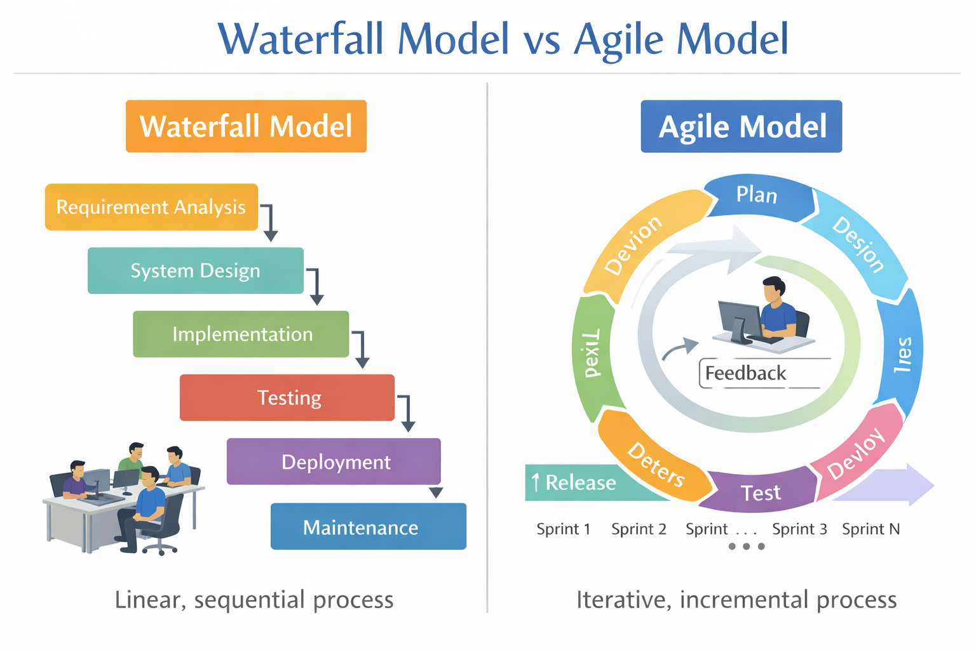
SDLC types
Waterfall: It is a linear and sequential SDLC approach.
Agile: Agile follows iterative development cycles (sprints).

Slide 8
Version Control
Version Control is a system that tracks changes in source code over time.
It allows developers to:
Track code history
Collaborate with multiple developers
Restore previous versions
Manage code safety
Example tools: Git, Subversion(SVN)

Slide 9
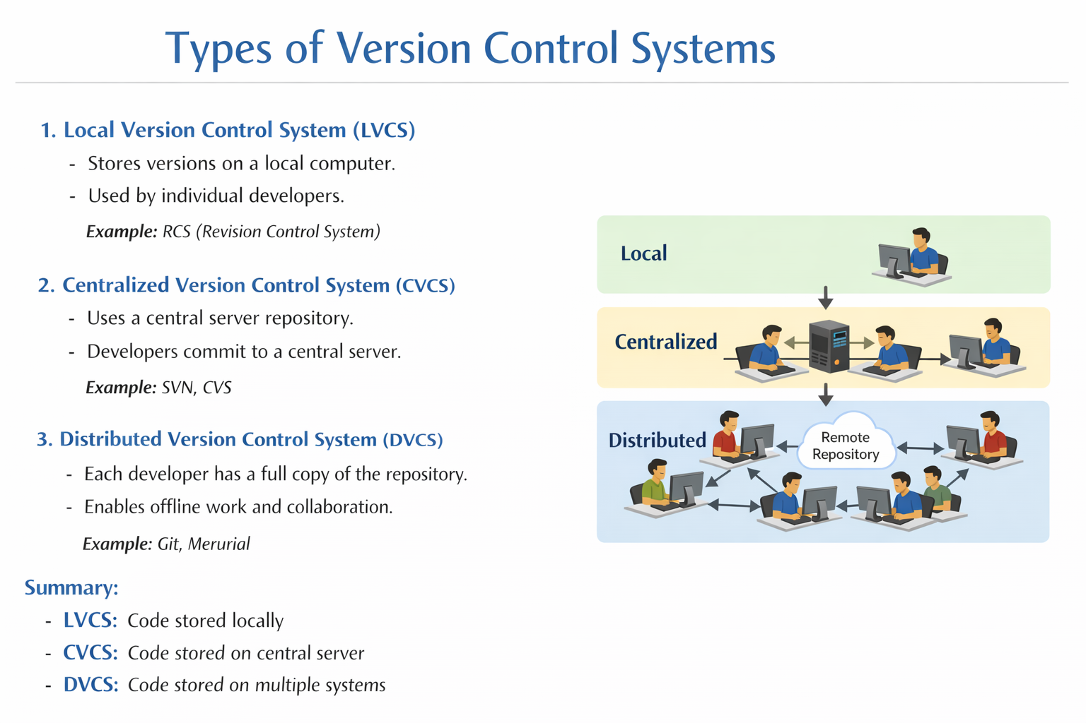
Types of Version Control Systems

Slide 10
Introduction to Git and Github
Git is the most popular version control system.
Key features:
Distributed version control system
Branching and merging
Fast and efficient
GitHub is a cloud platform that hosts Git repo.
Eg: Developer->commit code -> push to GitHub -> Team members review.

Slide 11
Difference between Git and GitHub
Features | Git | GitHub
Type | Version Control System | Cloud-based hosting platform
Purpose | Tracks code changes locally | Stores and manages repositories online
Internet | Not required | Requires internet
Usage | Used in local machine | Used for collaboration and remote storage

Slide 12
Important keywords in version control
Repository
Commit
Branch
Merge
Clone
Push and pull

Slide 13
Stages of Version control(Git)
Version control systems like Git manage code through several stages before storing it permanently.
Working Directory
Staging Area
Local Repository
Remote Repository

Slide 14
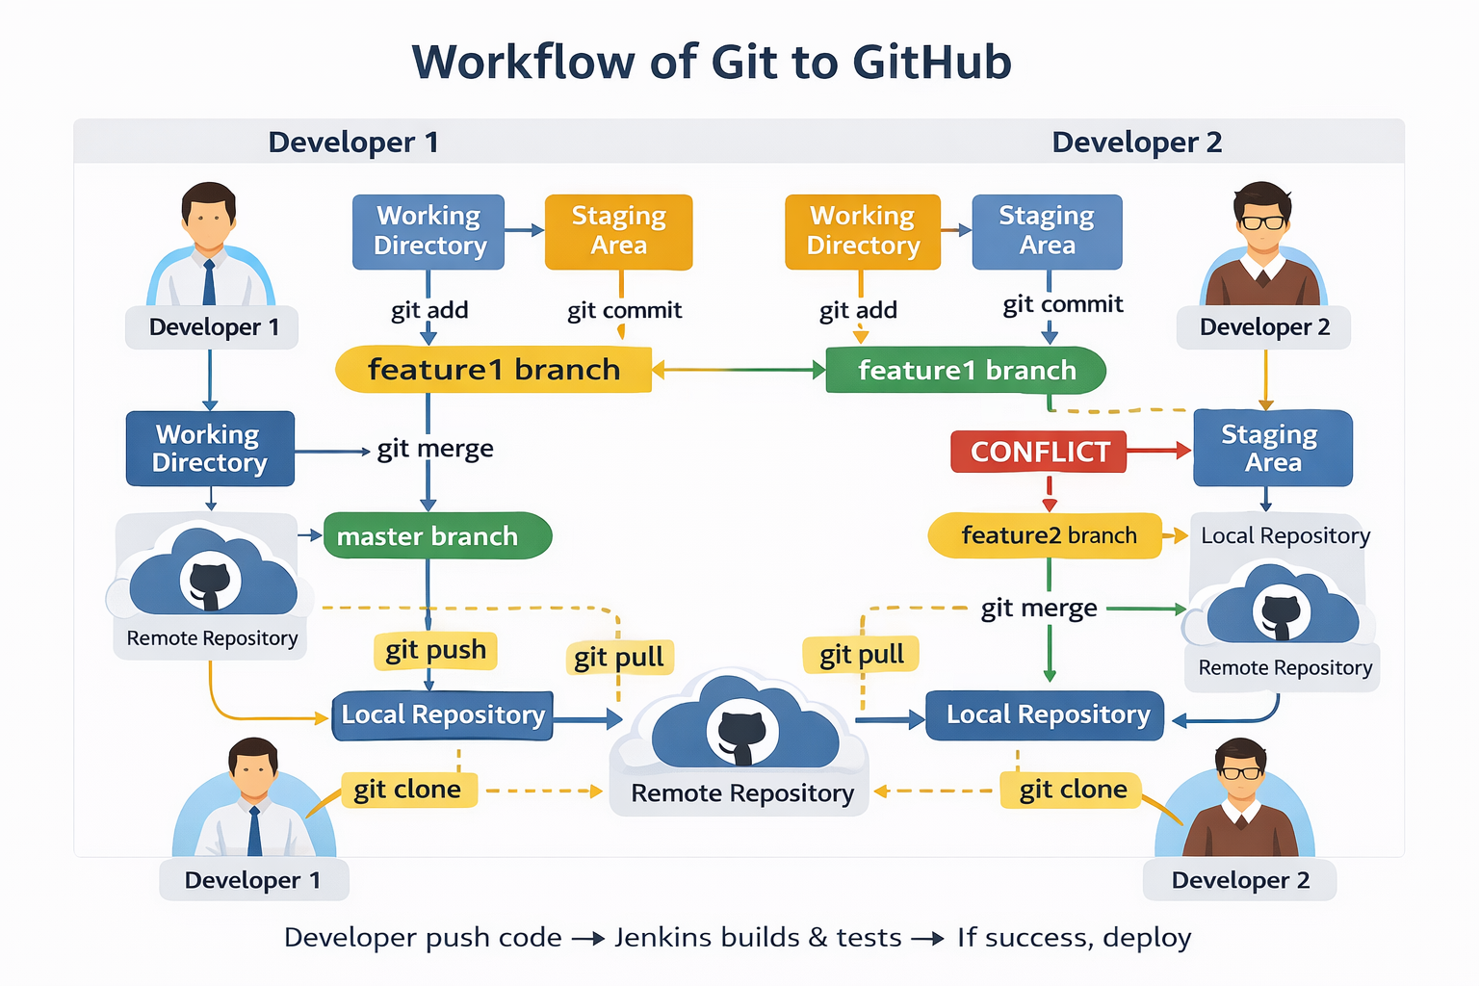

Slide 15
Introduction to Jenkins
Jenkins is an open-source automation server used to automate build, test, and deployment tasks.
In 2004 original name Hudson renamed it as Jenkins in 2011.
Why?
Speed up Development
Supports CI/CD pipelines

Slide 16
What is CI/CD
CI/CD stands for:
Continuous Integration
Continuous Delivery/ Development
It is a process that automates software building, testing and deployment.
Benefits:
Faster development
Reduced human errors
Faster bug detection

Slide 17
What is CI?
Developers frequently merge code into a shared repo.
Example Tool: Jenkins
Why CI?
1. Early Bug Detection
2. Frequent Code Integration
3. Improved Code Quality
4. Faster Development Cycle
5. Better Team Collaboration
6. Reduced Integration Issues

Slide 18
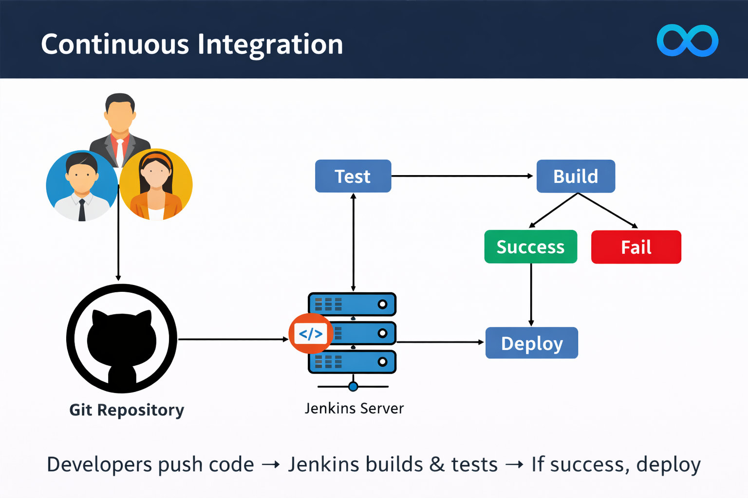

Slide 19
CD
Continuous Delivery: Build and test will done automatically, but deployment is done manually.
Continuous Deployement: Build, test and deployement done automatically.
Why?
Faster Releases, Automation of Deployment, Reliable Releases, Quick Feedback from Users and Consistency
Example:
Code → Build → Test → Deploy → Production

Slide 20
Continuous Delivery
Deployment Environment
Staging Environment
Production Environment
UI Testing
Load Testing
Integration Testing
Regression Testing
Staging Environment
Test

Slide 21
Continuous Delivery
Continuous Delivery
Staging encironment
Staging environment
Build
Test
Build
Deploy
Test
Deploy
customer
Manual
Deploy to
production
Continuous Deployment
Staging environment
Build
Test
Deploy
Customer
Automate
Deploye to
production

Slide 22
Workflow of CI/CD
Continuous integration
Continuous Delivery
manual
Test
Build
Acceptance
Testing
Deploye
in stage
Deploye to
production
Customer
Acceptance
Testing
Deploye
in stage
Deploye to
production
Customer
Test
Build
Automate
Continuous Deployement

Slide 23
Conclusion
SDLC, Version Control, and CI/CD pipelines are essential for modern software development.
They help teams:
Build software systematically
Manage code efficiently
Deliver updates quickly and reliably
Using these tools improves productivity, quality, and scalability.

